Slide 1
Capstone Project
Funding Patterns and High-Value Loan Drivers in EIB-Financed Projects (1980-2025)

Slide 2



Business Question
My question is:
Simple
Clear
Useful
Business-relevant
Primary Question:
What factors are associated with high-value loans in EIB-financed projects?
Secondary Questions:
How do signed amounts vary across regions (EU vs non-EU)?
Which sectors receive the highest financing?
How do time trends affect financing levels?
What proportion of projects are high-value (above median)?
Can I build a simple machine-learning model to predict high-value loans based on sector, region, and year?

Slide 3
Data Overview
Dataset includes:
~25,000 projects (after cleaning)
Region (European Union, Africa-Caribbean-Pacific, UK, etc.)
Sector (Energy, Transport, Credit Lines…)
Signed Amount
Signature Date
Country, Project Name, Status
Key Points:
Highly skewed signed amounts (median €26.2M, max €1.91B)
Decades of timeline data
Suitable for binary classification (high-value vs low-value)

Slide 4
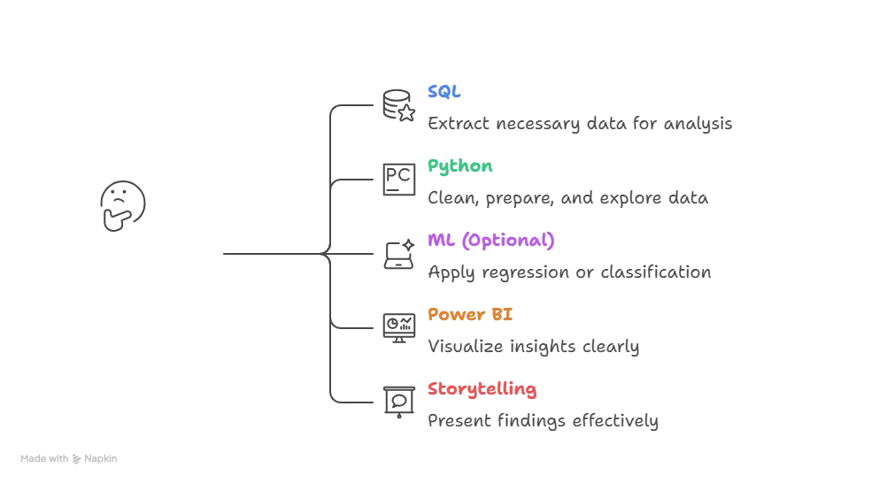

Capstone Workﬂow
Notes:
WHERE Signature_Date >= '1980-01-01’;

Slide 5
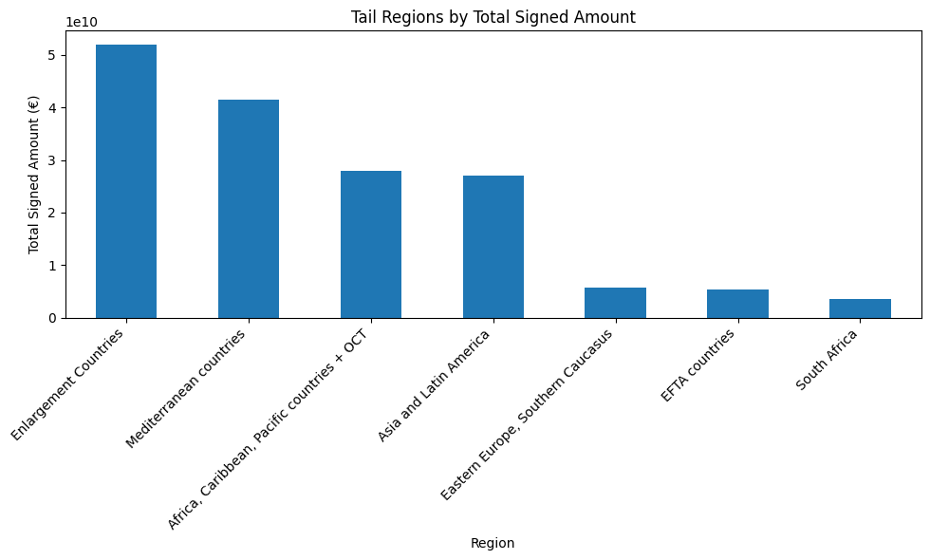
Key Insight 1 (Region)
Funding:
The European Union
ACP countries/UK follow
Mandate to support EU
*European Free Trade Association
Notes:
• The European Union overwhelmingly dominates total funding, far exceeding all other regions. • ACP countries and the United Kingdom follow at a much lower scale. • This distribution reflects the EIB’s core mandate to support EU development while providing targeted financing to partner regions.

Slide 6
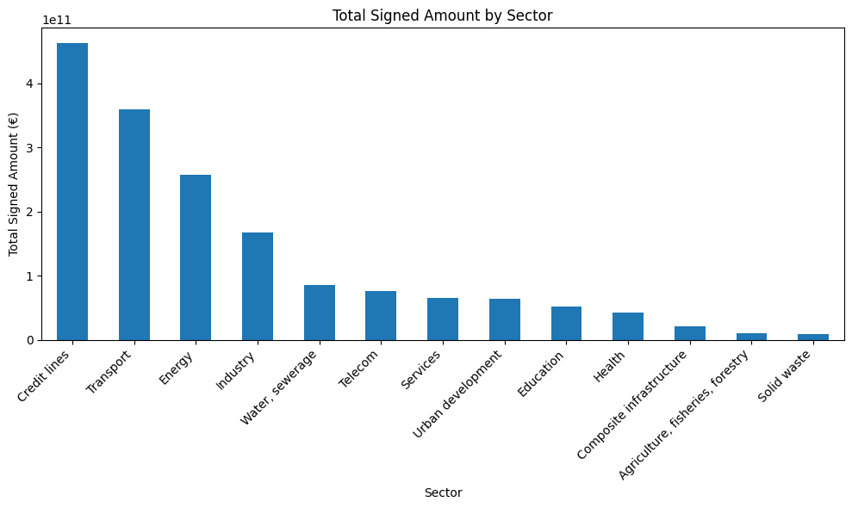
Key Insight 2 (Sector)
Funding:
Transport/Energy/Industry
Water/Education/Health
Security
Economic development
Notes:
• Energy, Transport, and Industry receive the highest total financing, accounting for most of the portfolio. • Social sectors (Health, Education, Water) receive steady but comparatively smaller investment. • These patterns underline EIB priorities around infrastructure, energy security and economic development.

Slide 7
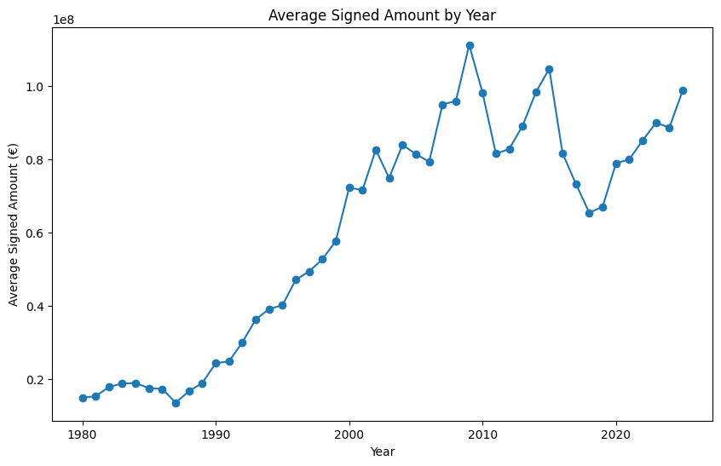
Key Insight 3 (Trend)
Time:
Volume rise after 2000
Macroeconomic cycles
Large investments
Notes:
• Project volumes rose sharply after 2000, indicating a major expansion of EIB lending activity. • Average signed amounts fluctuate across years in response to macroeconomic cycles and large investment programmes.

Slide 8
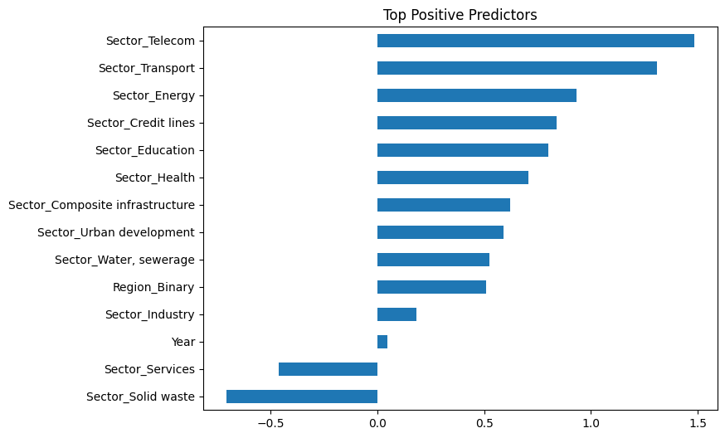
ML
Findings:
~65% accuracy
Sector/Year
Exploratory insight
Not operational decisions
Notes:
• A logistic regression model was developed to classify projects as above- or below-median signed amount. • After feature scaling, the model achieved ~65% accuracy. • Sector and year were the strongest predictors; EU vs non-EU region contributed moderate predictive influence. • The model is suitable for exploratory insight, not operational decision-making.

Slide 9
Recommendations
Use Power BI to explore funding distribution interactively
Track annual shifts in project volumes and signed amounts
Support planning and reporting
Treat machine-learning outputs as analytical indicators
Notes:
• Use Power BI slicers (Region, Sector, Year) to explore funding distribution interactively. • Track annual shifts in project volumes and signed amounts to support planning and reporting. • Treat machine-learning outputs as analytical indicators rather than prescriptive funding tools.

Slide 10
Conclusion
The European Union remains the dominant funding recipient
Energy, Transport and Industry attract the largest investments
Funding volumes and project counts increase sharply >2000
A simple ML model achieved ~65% accuracy
Next steps:
Agentic ???
Notes:
The European Union remains the dominant funding recipient, confirming the EIB’s core mandate while still supporting priority regions such as ACP countries and the UK.
Energy, Transport and Industry attract the largest investments, reflecting long-term strategic needs around infrastructure, mobility and economic resilience.
Funding volumes and project counts increase sharply after 2000, indicating sustained expansion in EIB activity and the scaling of large infrastructure programmes.
A simple ML model achieved ~65% accuracy, showing that sector and year meaningfully influence project value, while also confirming that ML should support—rather than drive—funding decisions.

